Slide 1
Recursion

Slide 2
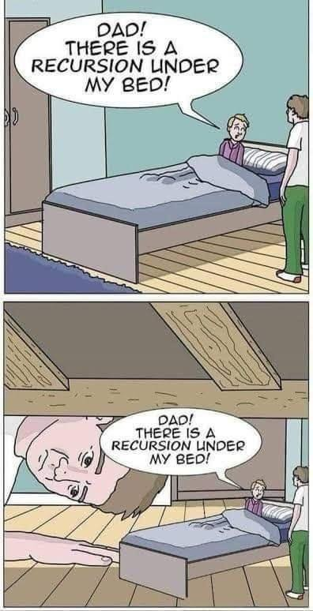
What is Recursion?
Act of a method calling itself.
Known as a recursive method.
Will keep calling itself if there is no condition to stop.
A way of problem solving by breaking down a broader problem into small parts.
Mostly used as an alternative of loop especially when using loop can be quite difficult.
Follows bottom to top then top to bottom approach (or can be considered vise versa as per convenience).

Slide 3
What is Recursion? (Cont.)
Pros : You may have to write less code.
Cons : Might have to deal with quite a few errors!

Slide 4
Loop versus Recursion
Loop | Recursion
Not much difference in terms of use. Both can be used to solve repetitive problems.
Constructs like for, while used. | Method calls itself and consists of a base case and recursive case.
Loop condition given to stop loop execution at a point. | Stops executing when base case is reached.
May not be easy to write for some complex problems. | May be easier to write complex problems and have more clarity.
Is more memory efficient. | Possibility of using more memory and resources due to stack overflow error.

Slide 5
Components of Recursive Method
Two components:
Base Case
Termination condition of the recursion process.
Recursive Case
Other cases other than the base case where the method keeps calling itself.

Slide 6
Structure of a Recursive Method
static return_type recursive_method(datatype parameter){
if (base case condition is satisfied){
return final_value; (optional)
}
else{ //recursive case
recursive_method(argument);
}
}
Can you tell what could be the issue if there was no base case?

Slide 7
Method Call from Another Method
We all have seen in the previous “Method” lecture where we can call a method from another method.
Ex: Finding the sum of a simple series 1 + 2 + 3
method1 will return the sum of the first two numbers to method2.
method2 will add the returned value with 3 and return it to the method2 call in the main method where the returned result is printed.
public class MethodExample {
public static void main(String[] args) {
System.out.println(method2(3));
}
static int method1(int a, int b){
int sum1 = a + b;
return sum1;
}
static int method2(int b){
int sum2 = method1(1, 2) + b;
return sum2;
}
}
Welcome to DrJava. Working directory is C:\Users\Desktop
6

Slide 8
Method Calling with Recursion
A recursive method works in a similar way. Except that the method will keep calling itself to keep adding the numbers and give the desired result.
And also, make sure the code works for sum of n natural numbers.
Ex: 1 + 2 + 3 + 4 + .... n
Change the number 4 in the method call to any other number and see if it works. You can also take n as user input.
public class recursion {
public static void main(String[] args) {
System.out.println(recursive_method(4));
}
static int recursive_method(int num){
if (num == 0){ //base case
return num;
}
else{ //recursive case
return num + recursive_method(num - 1);
}
}
}
Welcome to DrJava. Working directory is C:\Users\Desktop
10

Slide 9
Method Calling with Recursion (Cont.)
How does this work?
10 returned to main method and printed.
public class recursion {
public static void main(String[] args) {
System.out.println(recursive_method(4));
}
static int recursive_method(int num){
if (num == 0){
return num;
}
else{
return num + recursive_method(num - 1);
}
}
}
First call
4 passed to num
2 passed to num
1 passed to num
0 passed to num
3 passed to num
0 returned to last method call
return 2 + recursive_method(1) = 2 + 1 = 3
return 3 + recursive_method(2) = 3 + 3 = 6
return 4 + recursive_method(3) = 4 + 6 = 10
return 1 + recursive_method(0) = 1 + 0 = 1
4 + recursive_method(4 - 1)
3 + recursive_method(3 - 1)
1 + recursive_method(1 - 1)
2 + recursive_method(2 - 1)

Slide 10
Method Call Stack
Used to keep track of method calls in a data structure called Stack.
Each method, when called, gets allocated into the stack frame.
Each stack frame consists of the information about the called method like its local variables, arguments passed, returned value etc.
A call stack example shown on the right
following the example given in Slide 7.
method1()
Stack Frames
method2()
main()
Stack

Slide 11
Method Call Stack (Cont.)
For recursive method, every method call is also allocated a stack frame.
A call stack is shown for the previous example of recursion [Slide 9].
recursive_ method(0)
Returns 0
recursive_ method(1)
Returns 1 + 0
recursive_ method(2)
Returns 2 + 1
recursive_ method(3)
Returns 3 + 3
recursive_ method(4)
Called first so pushed into stack first.
Returns 4 + 6
main()
Stack

Slide 12
Factorial using Loop
public class factorial {
public static void main(String[] args) {
int fact = 1;
int number = 5;
for (int i = 1; i<=5; i++){
fact *= i;
}
System.out.println(fact);
}
}

Slide 13
Factorial Problem Breakdown
Factorial of a number can be broken down into smaller parts.
5!
120
5
*
4!
24
4
*
3!
6
3
*
2!
2
2
*
1!
1
1

Slide 14
Factorial using Recursion
public class factorial {
public static void main(String[] args) {
System.out.println(factorial_calculate(5));
}
static int factorial_calculate(int n){
if (n != 0) {
return n * factorial_calculate( n - 1);
}
else{
return 1;
}
}
}
Recursive case
Base case

Slide 15
More Examples of Recursion
Finding the minimum or maximum value in an array
Fibonacci series
Sorting algorithms, ex: selection sort, insertion sort etc.

Slide 16
THANK YOU!

